Slide 1

Project Team
Meet the experts behind this recommendation system research:
Dor Galon Meir
Selin Neomi Ivshin
Mickael Zeitoun
Ronen Gubin
Notes:
סלין

Slide 2
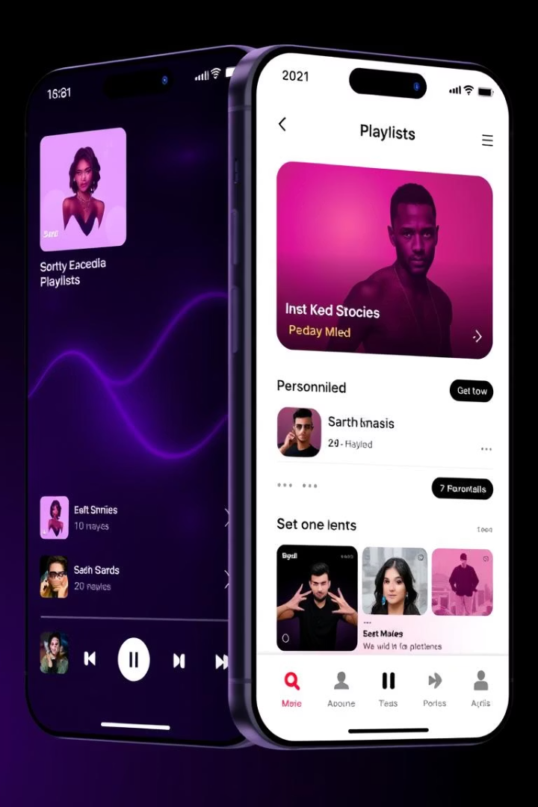



A Semi-Personalized System with Fuzzy Membership for Cold-Start User Recommendation in Music Streaming Apps
Focus
Innovation
Improving cold-start user recommendations in music streaming apps using fuzzy clustering.
Semi-personalized approach with probabilistic cluster memberships.
Target
Enhance first-day user experience before rich interaction data accumulates.
Notes:
סלין

Slide 3
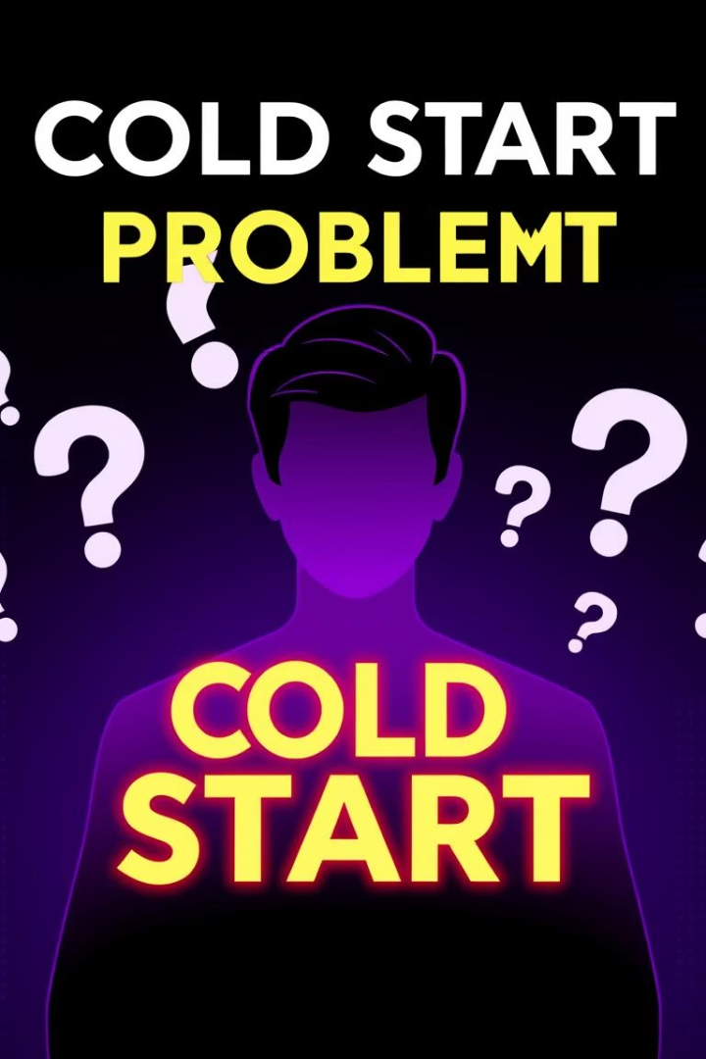
Background: Cold-Start Challenge on Deezer
Cold Start Problem
Current System
The difficulty of making accurate predictions when no historical data yet exists.
Assigns newcomers to a single cluster based on sparse demographics and interactions.
New User Data
A new user’s data is often sparse - just demographics
and a handful of interactions.
Notes:
סלין

Slide 4

Motivation & Goal
Motivation
Goal
≈ 50% of newcomers skip many tracks initially.
Deliver engaging, genre-spanning recommendations from day one.
25% leave within the first month.
Achieve this before accumulating rich interaction data.
Poor early experience harms user satisfaction and slows Deezer’s growth.
Notes:
סלין

Slide 5

Data Description
Data Types
Data Summary
Listening log: Implicit feedback like played, skipped or liked songs
Train set: 70K warm users
Validation: 20K warm users
User metadata: Demographics such as age, country and platform
Test set: 10K cold users
Onboarding data: Initial actions during signup, such as selected genres, favorite artists or skipped songs (used for cold users).
2579 total columns, 3 demographics, 36 interaction features
Notes:
רוני -> מיכאל מציג מחברת EDA

Slide 6
Moving to notebook – Exploratory Data Analysis

Slide 7
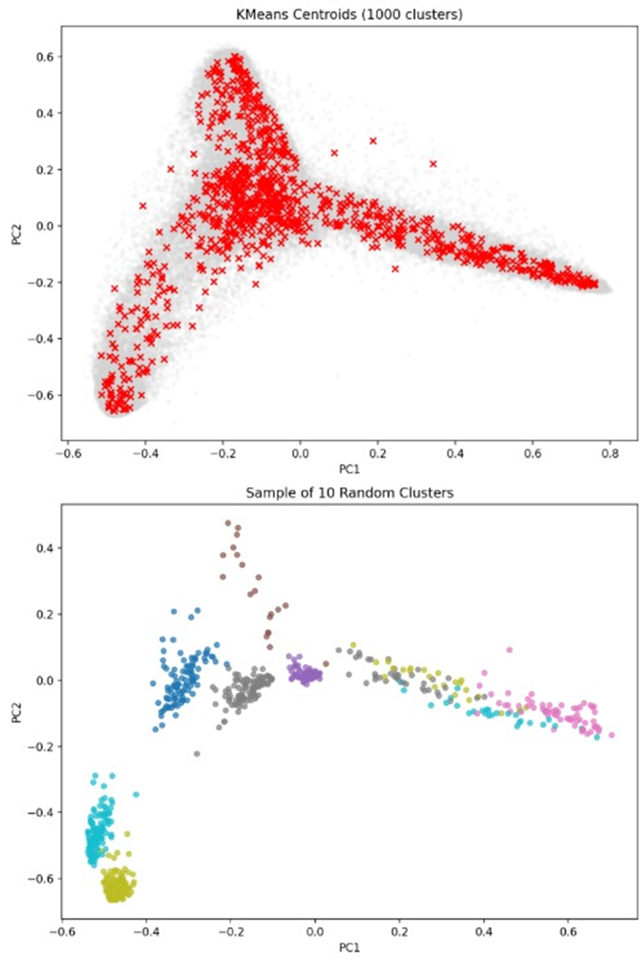
Exploratory Data Analysis:
Cluster density – 1,000 clusters spread across the space according to their centroids
Cluster density – 1,000 clusters spread across the space according to their centroids
Notes:
מיכאל

Slide 8




Current Solution Overview – The system is semi-personalized, not fully individualized
Warm Users
Cold Users
Recommendation
Create embedding vectors for warm users from TT-SVD matrix.
Train a Neural Network to predict cold users embedding.
Neural network predicts embedding. Cold user is assigned to precomputed single cluster in the latent space.
Fixed playlist based on cluster profile recommended to cold users.
Notes:
רוני

Slide 9
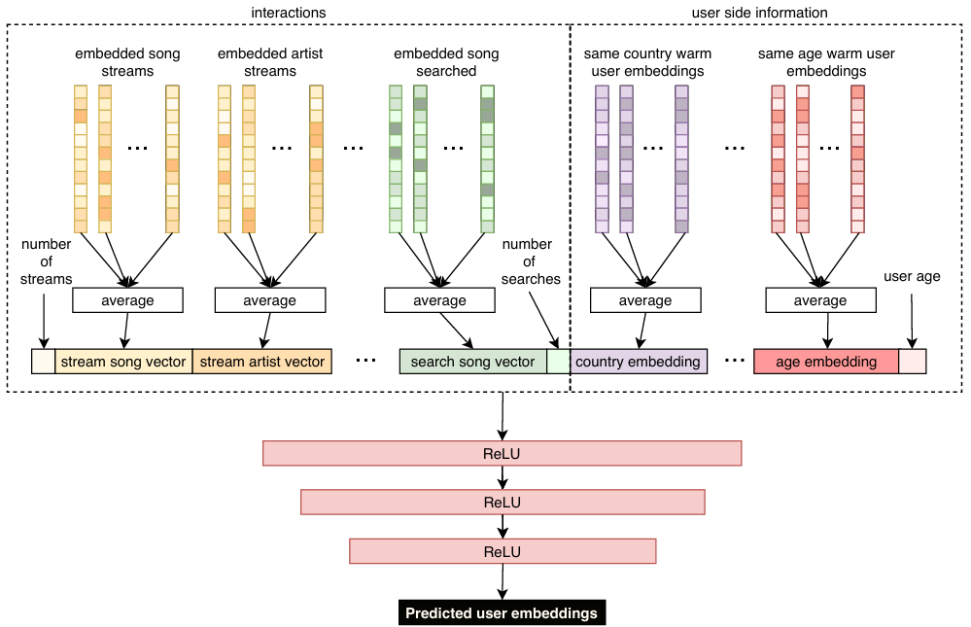
Embedding Prediction Workflow
Notes:
רוני

Slide 10
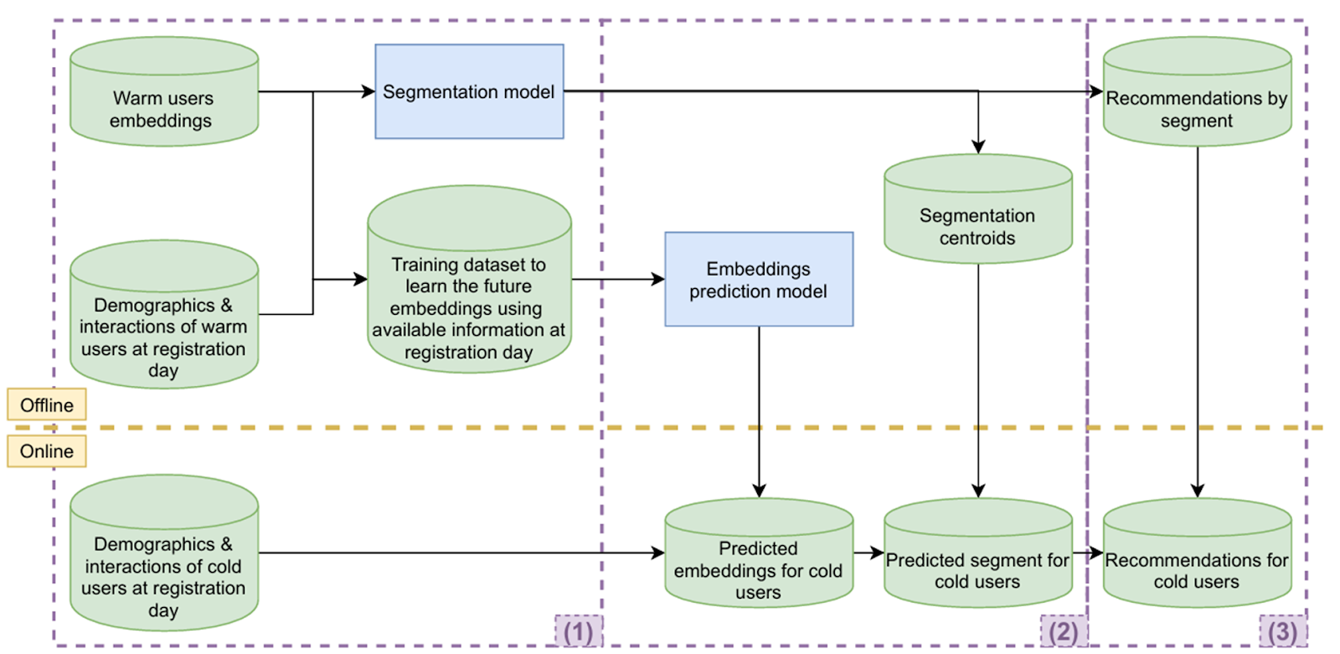
End-to-End Recommendation Process
Notes:
דור

Slide 11

Moving to notebook – Current Results

Slide 12
Current System: Pros and Cons
Pros
Cons
Scalable - Clustering the embedded representation of the users, to fixed set of clusters.
Lacks robustness in the recommendations that base only on 1 cluster.
Uses a deep feedforward neural network, enabling accurate cold-user representation even from sparse or partial input features.
Base on fixed clusters profiles rather than dynamically updated ones.
Dynamic updates are hard to implement due to the high volume of changes, requiring frequent model retraining.
Once trained, the classifier is lightweight and fast, making it suitable for real-time prediction in production
Notes:
דור

Slide 13
Our Solution: More flexible recommendation, reflecting varied preferences
The current system assigns each cold user to a single cluster, assuming they fit one specific profile.
Each cluster is linked to a fixed 50-track playlist, created based on the listening history of warm users in that cluster.
This approach fails to capture the diversity of cold users, who may have interests across multiple genres.
As a result, recommendations may be too narrow or inaccurate.
Our solution introduces fuzzy membership, allowing a cold user to belong to multiple clusters with different probabilities
Notes:
דור

Slide 14
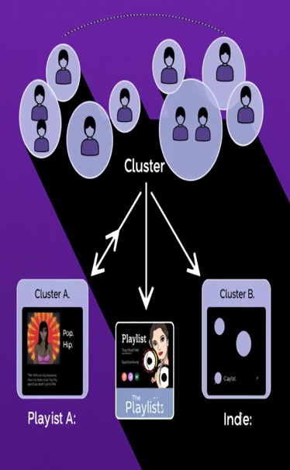
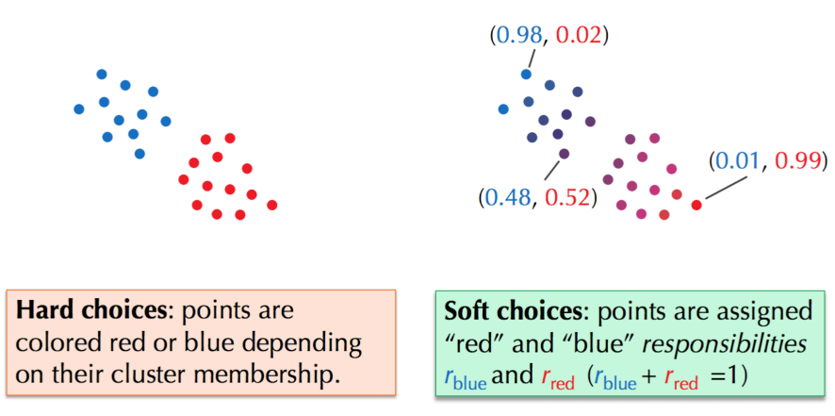
Soft Membership
Instead of recommending only the most popular tracks from one cluster, we propose assigning cold users to multiple clusters with probabilities. This way, recommendations are drawn from several clusters based on how likely the user is to belong to each, resulting in more personalized playlists.
Notes:
דור

Slide 15
Moving to notebook – Our Solution

Slide 16
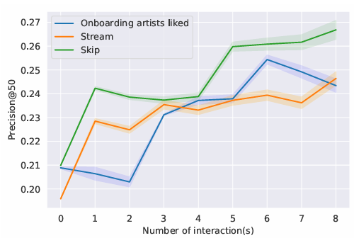
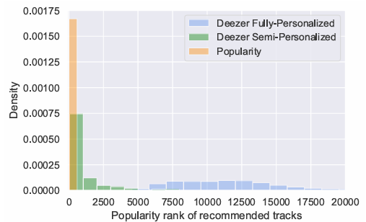
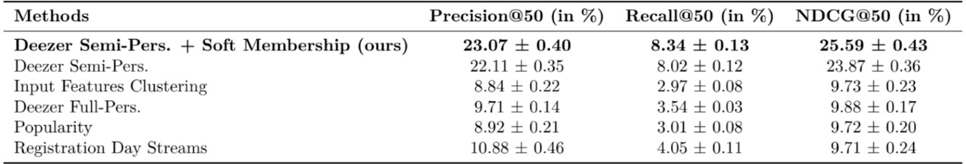
Results
Notes:
רוני

Slide 17
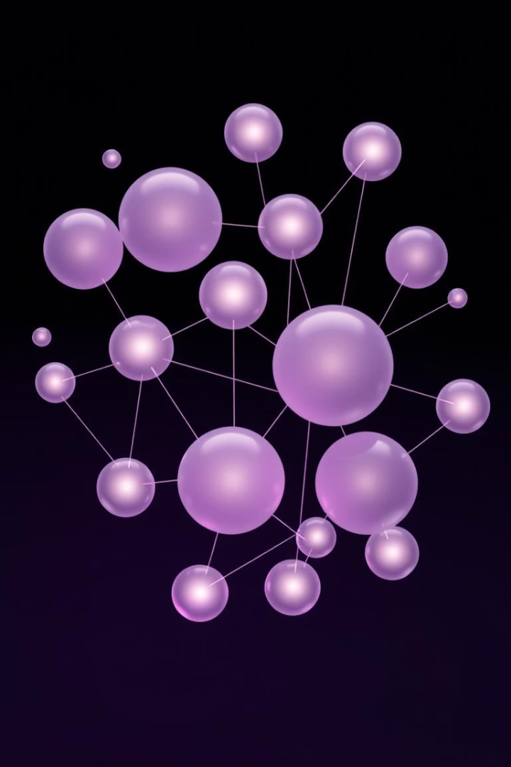
Conclusions
Improved Results
Soft membership produces a better playlist recommendation to cold start users.
Generalization
Model better generalizes recommended user profiles.
The model creates more diverse playlists.
Notes:
סלין

Slide 18



Future Work
Neural Network Optimization
Hybrid Methods
Approach that combines semi- and fully-personalized methods, depending on the cold user's interaction count. This can create a more robust model capable of handling different user scenarios.
Using generalization techniques like dropout, which simulates the cold-start problem by randomly hiding parts of the input data during training.
Notes:
דור

